Slide 1
Little Rascals
A View of New York City’s Universal Pre-School Program

Slide 2

Agenda
Background
Analysis
Closing Remarks

Slide 3
Background

Slide 4

Background
In September 2014, New York City (“NYC”) launched its universal pre-school (“Pre-K”) program for children of age four, one year after first term Mayor Bill de Blasio took office.
Universal Pre-K Rollout in NYC
In September 2018, four years later, the universal Pre-K effort expanded to included children of age three (“3-K for All”).

Slide 5
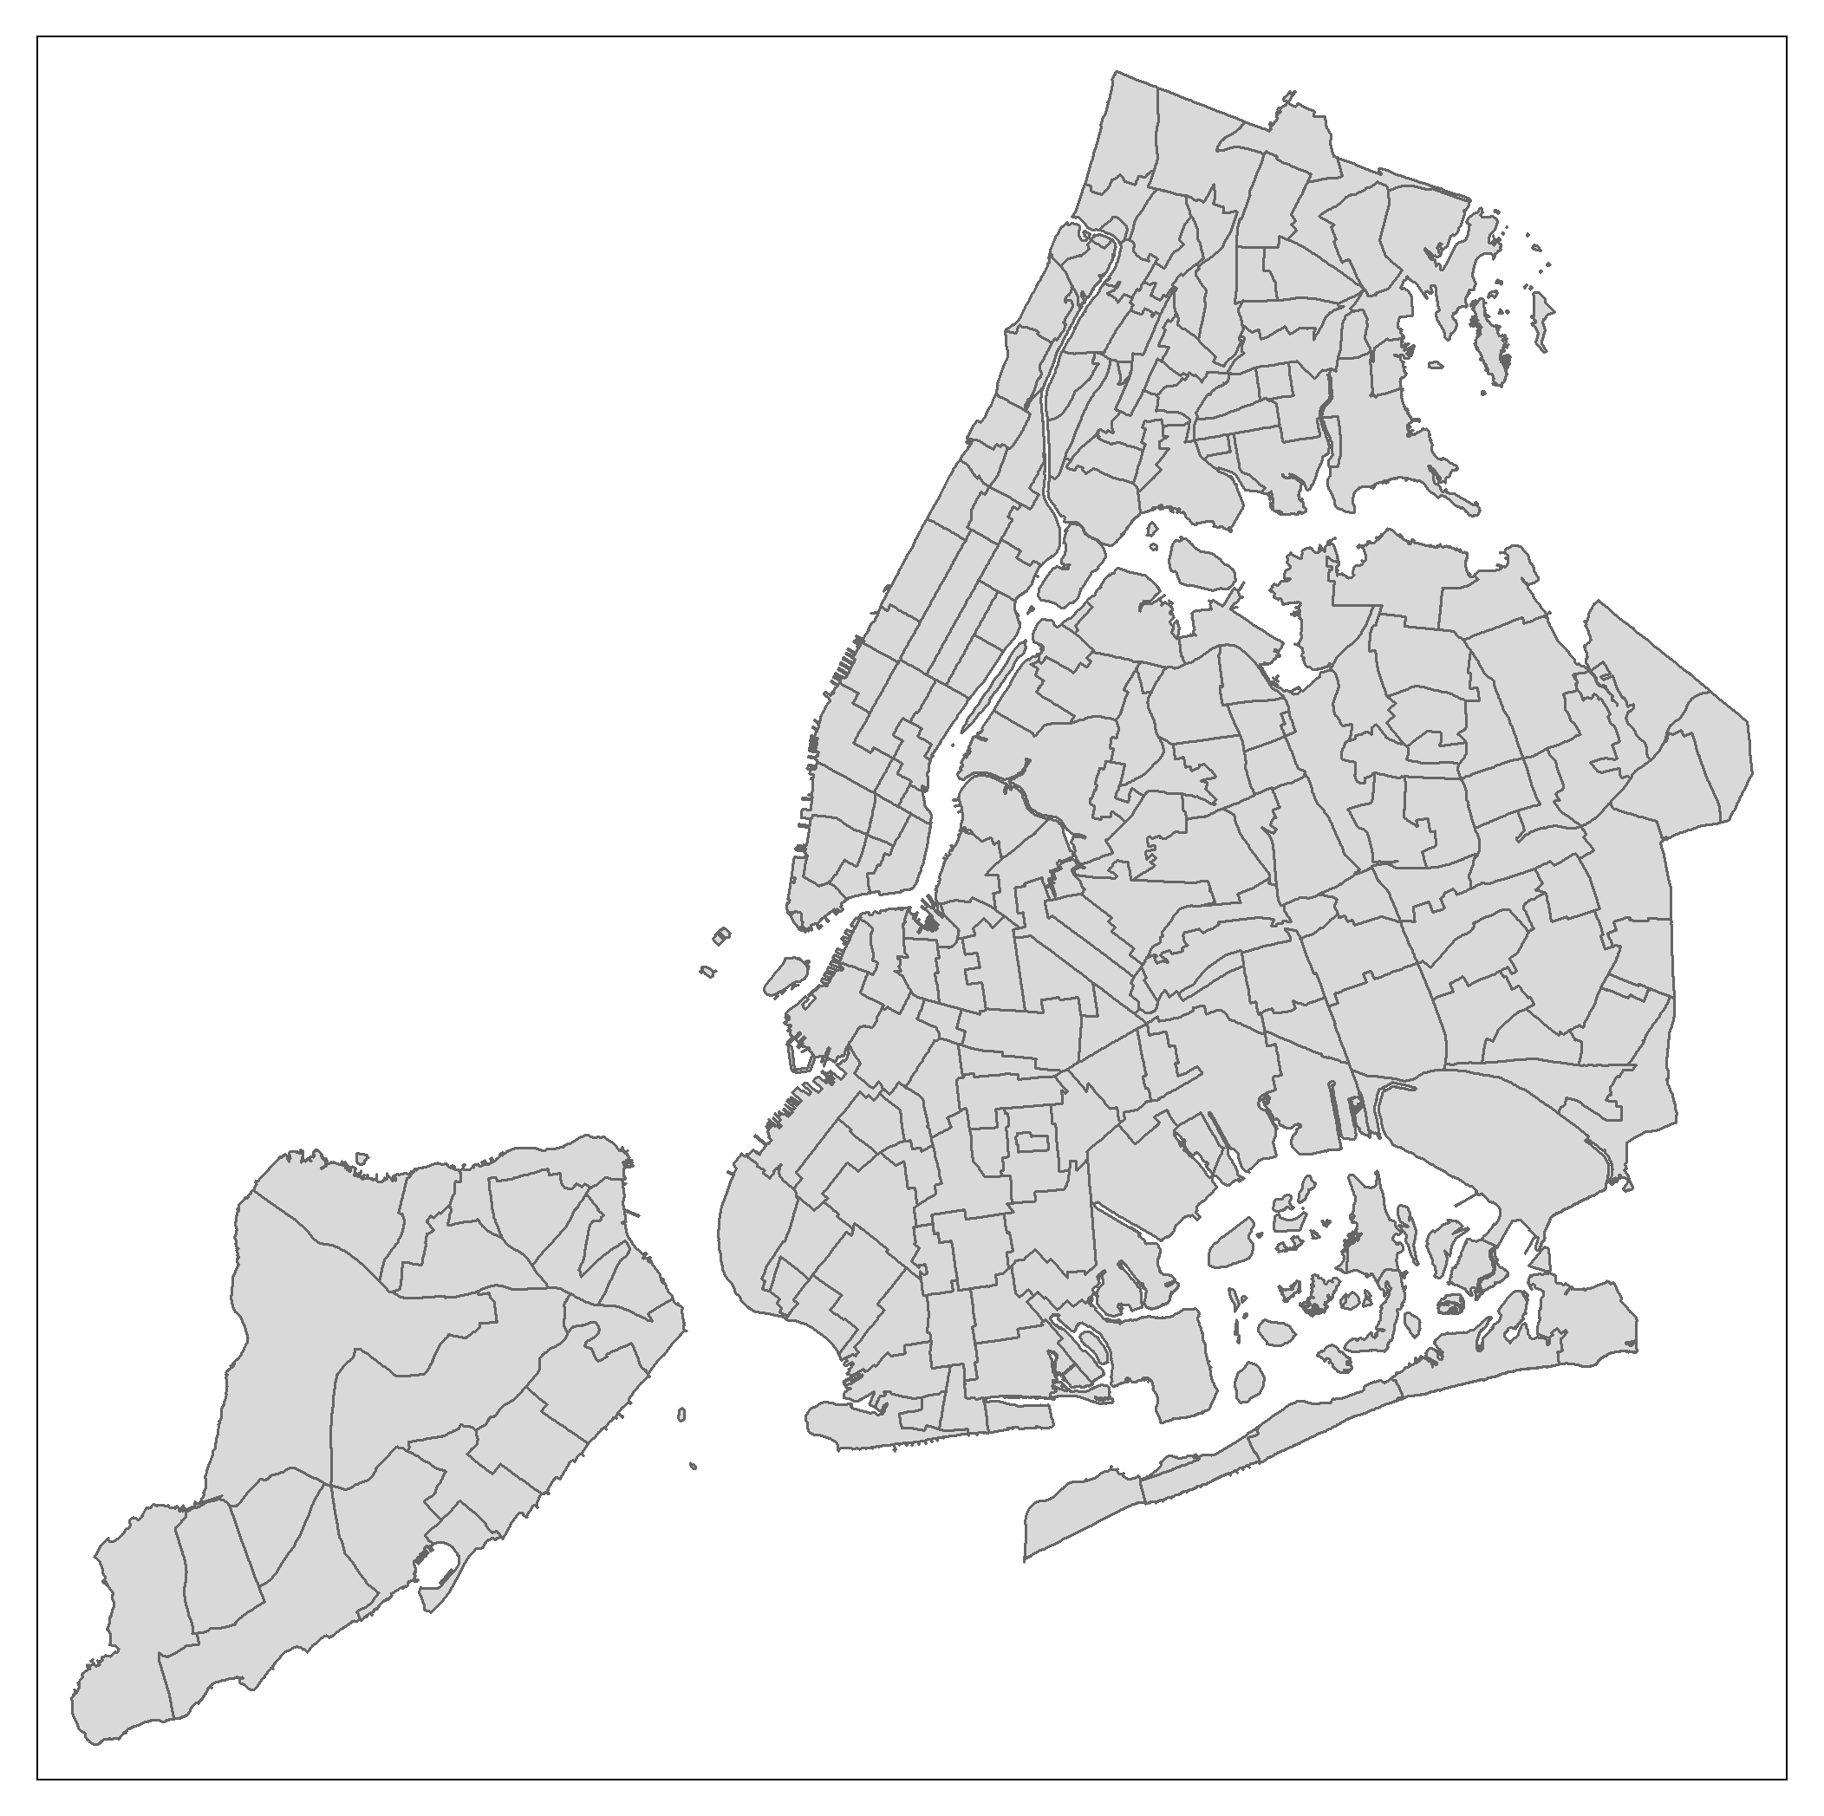
Background Neighborhood Transit Areas (NTAs)
Segmentation layer for purposes of planning and projection estimates.
NTAs encompass whole census tracts.
NTAs (195 in total) represent a balance between a high-level view of boroughs (5) or community districts (59) and a very detailed view of census tracts (2,168).

Slide 6
Analysis

Slide 7

Map Analysis
Utilizes NTA segmentation with 2010 census population data and Pre-K school location as of September 2018.
Two views – one based upon total number of seats in an NTA and a second using the ratio of seats to population within an NTA (“seats per 1000”).
User can filter by borough or see all of NYC and identify the five lowest NTAs on the selected metric.

Slide 8
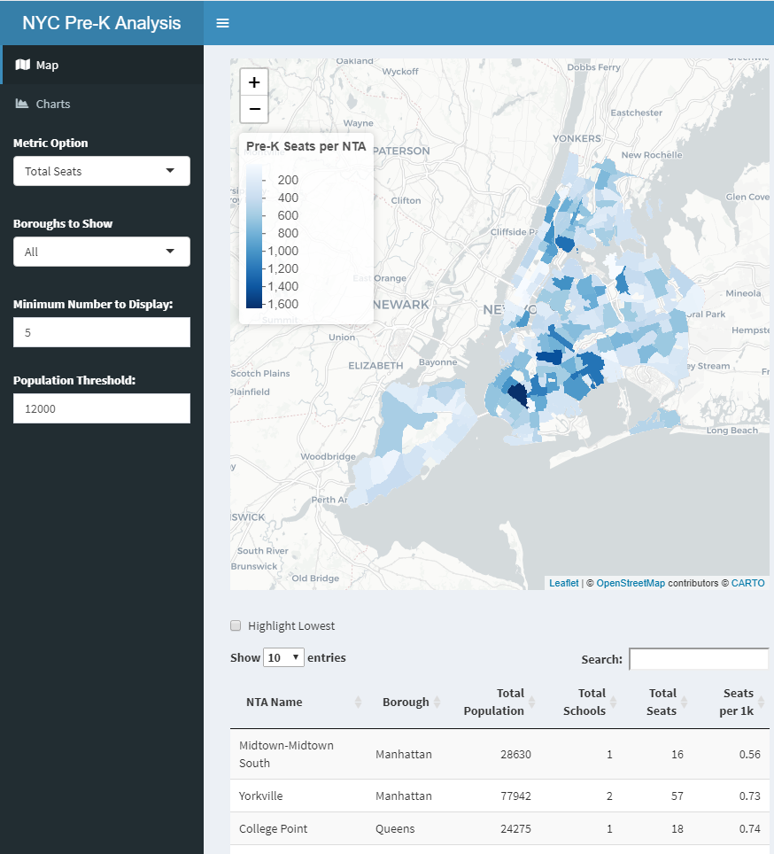
Map Analysis

Slide 9
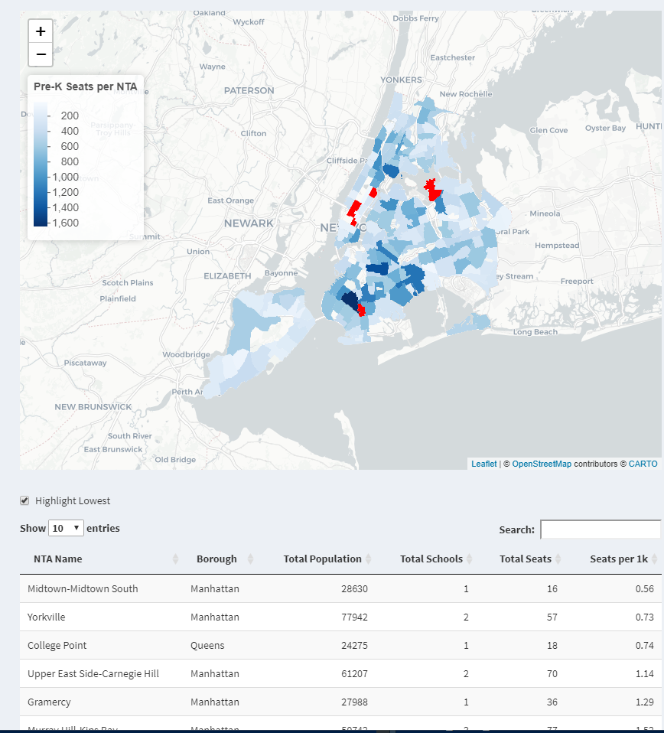
Map Analysis Ability to highlight areas with lowest school footprint

Slide 10
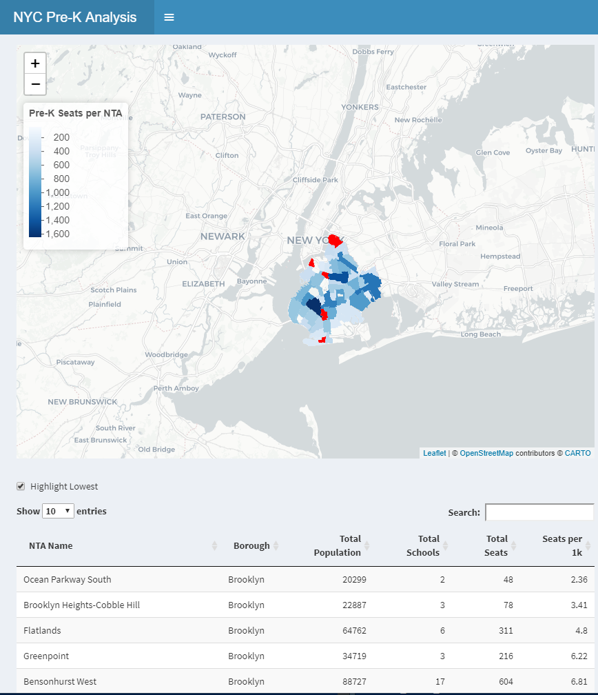
Map Analysis Can filter based upon an individual borough versus the entire city

Slide 11
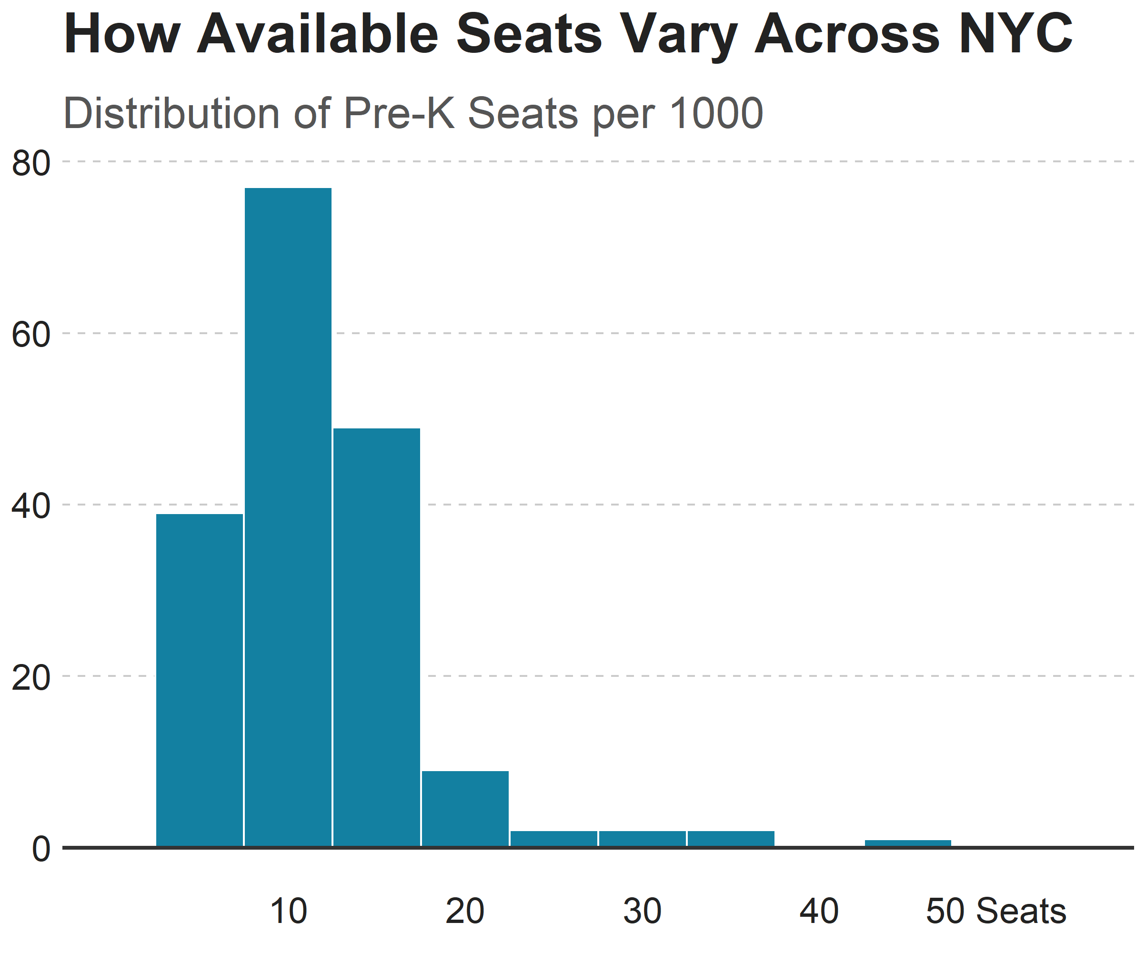
Numerical Analysis

Slide 12
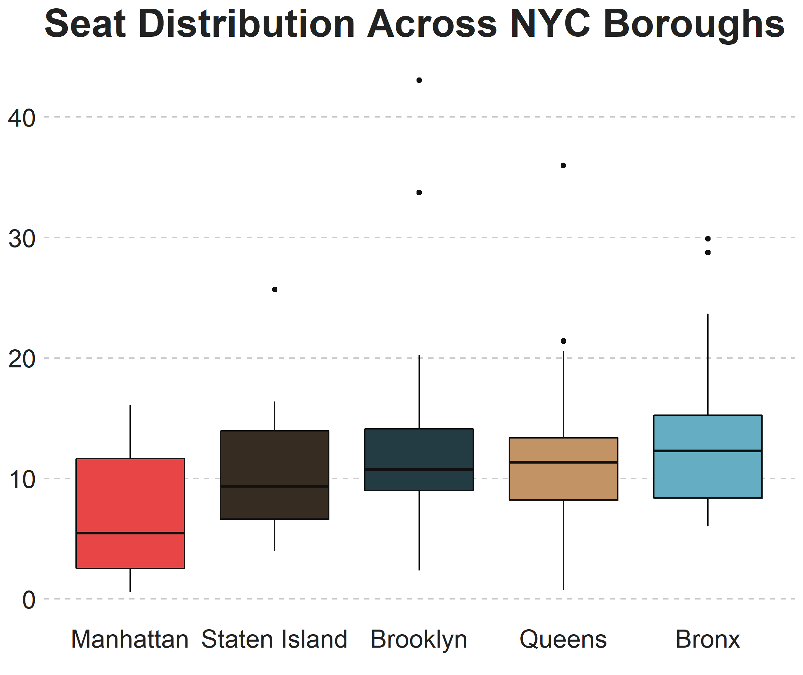
Numerical Analysis

Slide 13
Closing Remarks

Slide 14
Closing Remarks
At a high level, it appears that the availability of seats thorough the NYC metro area is roughly consistent.
Manhattan appears to be a little below the other boroughs in terms of coverage. This may be due to a higher presence of commercial areas, which this analysis does not factor in.
Future Idea(s):
Analyze seat concentration at the School District level (32 in total), which is more aggregate than an NTA and may be more appropriate for city government planners.

Slide 15

Questions

